Slide 1
Presented by: Lisa Richardson & Alice Morris
EDNA Disability and Accessibility Advisors
Notes:
Lisa
Just to add we will be sending out the slides from todays presentation which will include the EDNA poster and upcoming events that we have running over the next few months. There will be a little quiz at the end as we are aware that some of us wish to fall asleep throughout a presentation – but should you feel overwhelmed at any point please feel free to go make yourself a hot drink and come back to us! Please do feel free to add any comments in the chat and we can have time at the end of the presentation to discuss in more detail. You will note that we will be reading from the slides today to ensure we cater for all needs.

Slide 2
What is EDNA?
EDNA stands for Employee Disability and Neurodivergent Advice Service
A confidential information and advice service for NHS colleagues in Hampshire & Isle of Wight, who are living with a disability, long term condition and/or are neurodivergent
EDNA offers support and advice for workplace reasonable adjustments, information, signposting, advocacy, provision of manager training and more
The service is provided by a specialist team, who offer one-to-one advice and a safe space to talk, as well as help with areas such as: employment rights and HR advice
Notes:
Lisa

Slide 3
What is EDNA’S aim?
Provide a comprehensive advice service
Create a healthier and comfortable working environment
Build a more inclusive culture within the workplace
Empower colleagues with timely and accessible information
Notes:
Lisa

Slide 4
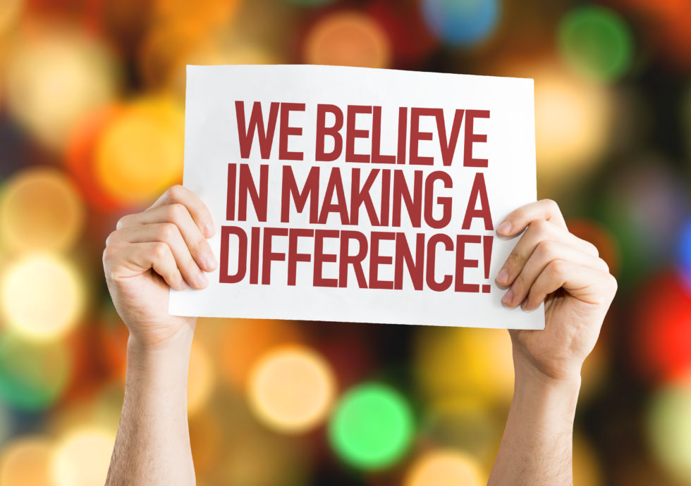
Advocacy
A tailor-made service that is tailored to the individuals need
Ease of Access
Employees do not need to have a formal referral made to us; they can self-refer to EDNA
EDNA provides consistency and partnership
We deliver knowledge and expertise
Support with Access to Work
From the start to finish
EDNA can create easy pathways
We can signpost our people to staff networks, charities and additional resources
Build networks
By working together, we build networks, help break down barriers, help create a joined-up service
Inclusion for all
We can help celebrate positive practices and provide support and advice for all, when needed most
What makes us different?
Notes:
Alice
https://eonoffice.com/sticky-notes/inspiring-your-team-to-volunteer/

Slide 5
MEET THE TEAM
A little bit about the EDNA Team
Notes:
Alice

Slide 6
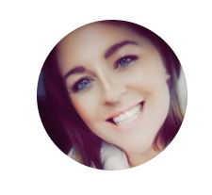
Lisa has 14 years’ experience working within the NHS With the first two years working within the community looking after patients with complex needs and end of life care. She has worked in a clinical background working on the wards both in Surgery and Specialist Medicine working as an Associate Nurse Practitioner. She provided a service to patients and supported colleagues who were living with a disability, long term condition and or who were neurodivergent.
Lisa studied at Solent University in `Class 2015` where she was diagnosed with Dyslexia, Dyscalculia and Dyspraxia, this didn’t stop her, she sourced support for reasonable adjustments towards her studies and came out of university with a distinction.
For the past seven years Lisa has worked for the Occupational Health Department within UHS as an Accessibility and Disability Officer where she provided advocacy, advice and support for reasonable adjustments in the workplace for employees who lived with a disability, long term condition and/or neurodivergence.
Lisa believes in a sense of belonging and acceptance and wants to share this journey with you and make it be the best it can be, so that we all feel a sense of achievement and as a whole being, where inclusivity is all.
Lisa Richardson
Disability & Accessibility Advisor
Lisa was nominated a hospital hero for her determination, commitment and her remarkable success in creating a valuable service for her colleagues. She is proud of her achievements in making it evolve to what it is today and has clear passion for her colleagues and a real sense of drive to take the EDNA service forward across many other organisations within the Hampshire and Isle of Wight region.
Notes:
Alice

Slide 7
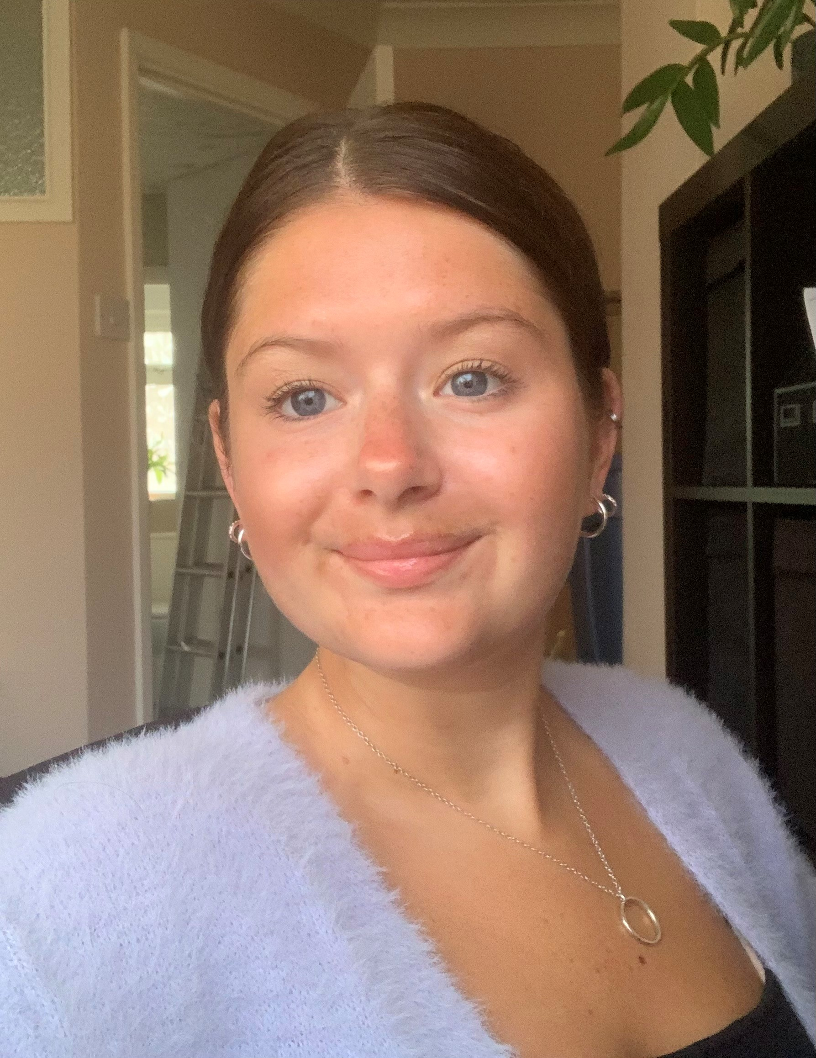
Alice has worked within the NHS for four years; within the first two years Alice worked for the Children & Families Service as a Speech & Language Therapy Assistant where she worked within various settings; organising and delivering therapy activities. Alice has supported individuals who have a disability and those who are on the autistic spectrum.
For the past two years Alice has been working as part of the Operational Management Team in Solent NHS Trust’s Vaccination and Health Inequalities Service. Alice was involved in the development and coordination of vaccination centres across Hampshire & IOW and within a variety of community settings.
Prior to Alice's time working for the NHS, she has enjoyed working in a range of different roles supporting people with social and physical learning disabilities. This led Alice to peruse a degree in Special Educational Needs & Disabilities which has given her a broader understanding of how to better support individuals with a disability and/or long-term condition.
Alice believes that a sense of belonging ties diversity, equality, and inclusion together. Ensuring that colleagues are respected, valued, and understood whilst being their authentic self.
“Alice is excited and passionate about the service and looks forward to offering support and advice to NHS colleagues and helping them flourish in the workplace.”
Alice Morris
Disability & Accessibility Advisor
Alice was diagnosed with Dyslexia, Dyspraxia & Dyscalculia during her time at university in 2015 where she sourced support for reasonable adjustments towards her studies and has continued to use these in everyday life.
Alice talks openly about her disability as it is an important part of who she is.
“Good friends will stop seeing condition or impairment as a barrier but just an aspect of your life. It won’t be the only thing they know about you."
Notes:
Lisa

Slide 8
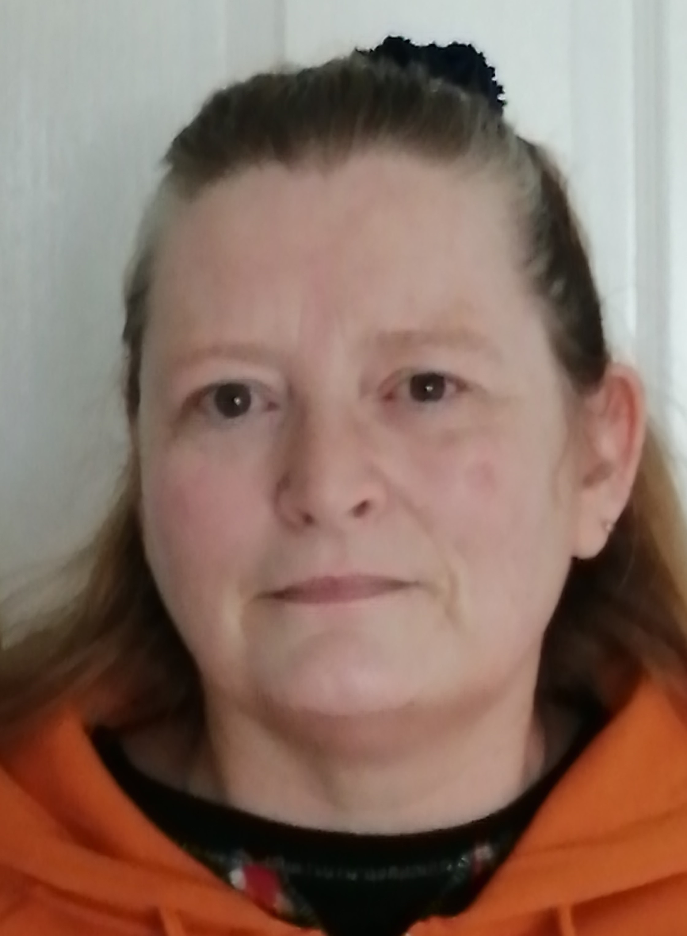
Jacquie has many years experience of working in Childcare.
Jacquie has 5 children, 1 who became deaf following meningitis at 16 weeks, 1 who had severe asthma and eczema and then at 16 her eldest son unfortunately took his own life. This has led to Jacquie having multiple health issues, including depression and anxiety, following his death.
Jacquie had a very simple accident whilst away on a Scout camp, which left Jacquie with chronic pain and has undergone many spinal operations. She is now registered disabled and has mobility issues.
Jacquie vowed never to let any of her disabilities stop her and worked hard to stay in work and learnt to walk again. Her goals are to stay at work even if its 1 day a week, and has the support and assistance of her main carer (her husband) and her therapy Maine Coon Cat.
Since her accident Jacquie has achieved several NQ3 qualifications and says her proudest moment was when she achieved her HNC in business management – through distance learning whilst also holding down a full-time job and her busy family life.
Jacquie believes for us to put “patients first”, we must firstly put our staff first.
She believes, if we look after our staff, we will have less sickness, reduced turnover of staff, therefore creating a more inclusive workforce.
We want our staff to be able do their roles alongside their colleagues along a level playing field.
Jacqueline Holt
EDNA Administrator
Jacquie worked closely with the Equality, Diversity and Inclusion team to set up a new staff network to support employees with a disability and/or long term condition.
Notes:
Alice

Slide 9
Why we started the service, what impact do we want, how passionate are we?
Keep staff supported
Improve staff retention, and morale
Benefit our employees’ Health and Wellbeing
Focus on employee’s experience within the workplace
Solve problems before they impact our colleagues and the service
Employees who experience burn out are less productive, incur more health costs and are at greater risk of serious illness!
Unless employees feel their best both physically and emotionally, they can never be fully engaged with their organisation!
EDNA is about employee engagement, with its overall aim to improve the wellbeing of the workforce.
Notes:
Alice

Slide 10
Not all impairments are visible
You might have heard about this over the past few years as the awareness of invisible disabilities has risen. These include neurodivergent conditions like autism and ADHD, and mental ill health, Cystic Fibrosis and many more.
Some people with invisible disabilities wear sunflower lanyards to indicate that they are disabled so they can use disabled facilities without being questioned.
Notes:
Lisa
https://healthwatchwiganandleigh.co.uk/advice-and-information/2020-09-15/hidden-disabilities-what-do-sunflower-lanyards-mean

Slide 11
Let's look further into what we can offer support with!
Notes:
Lisa

Slide 12
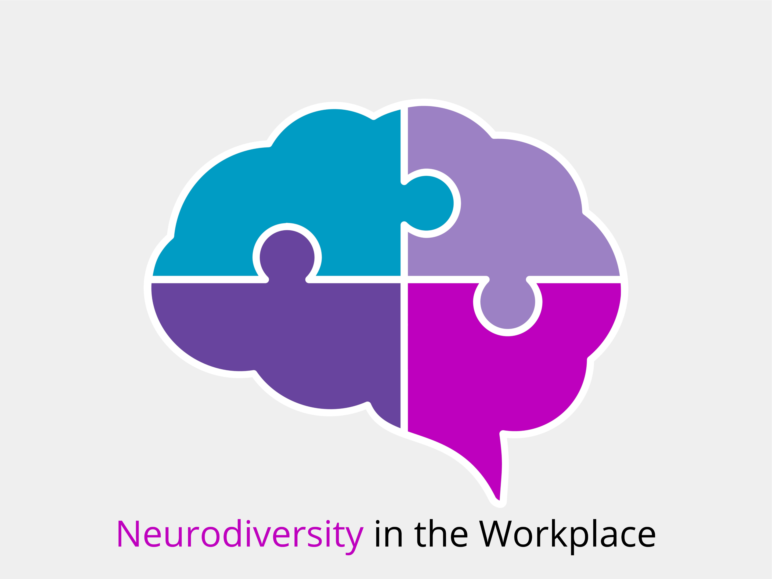
Notes:
Lisa
https://bhayanilaw.co.uk/neurodiversity-in-the-workplace/

Slide 13
WHAT IS NEURODIVERSITY?
“Neurodiversity describes the idea that people experience and interact with the world around them in many different ways”
“There is no one "right" way of thinking, learning, and behaving, and differences are not viewed as deficits”
Notes:
Lisa
What is neurodiversity? - Harvard Health

Slide 14
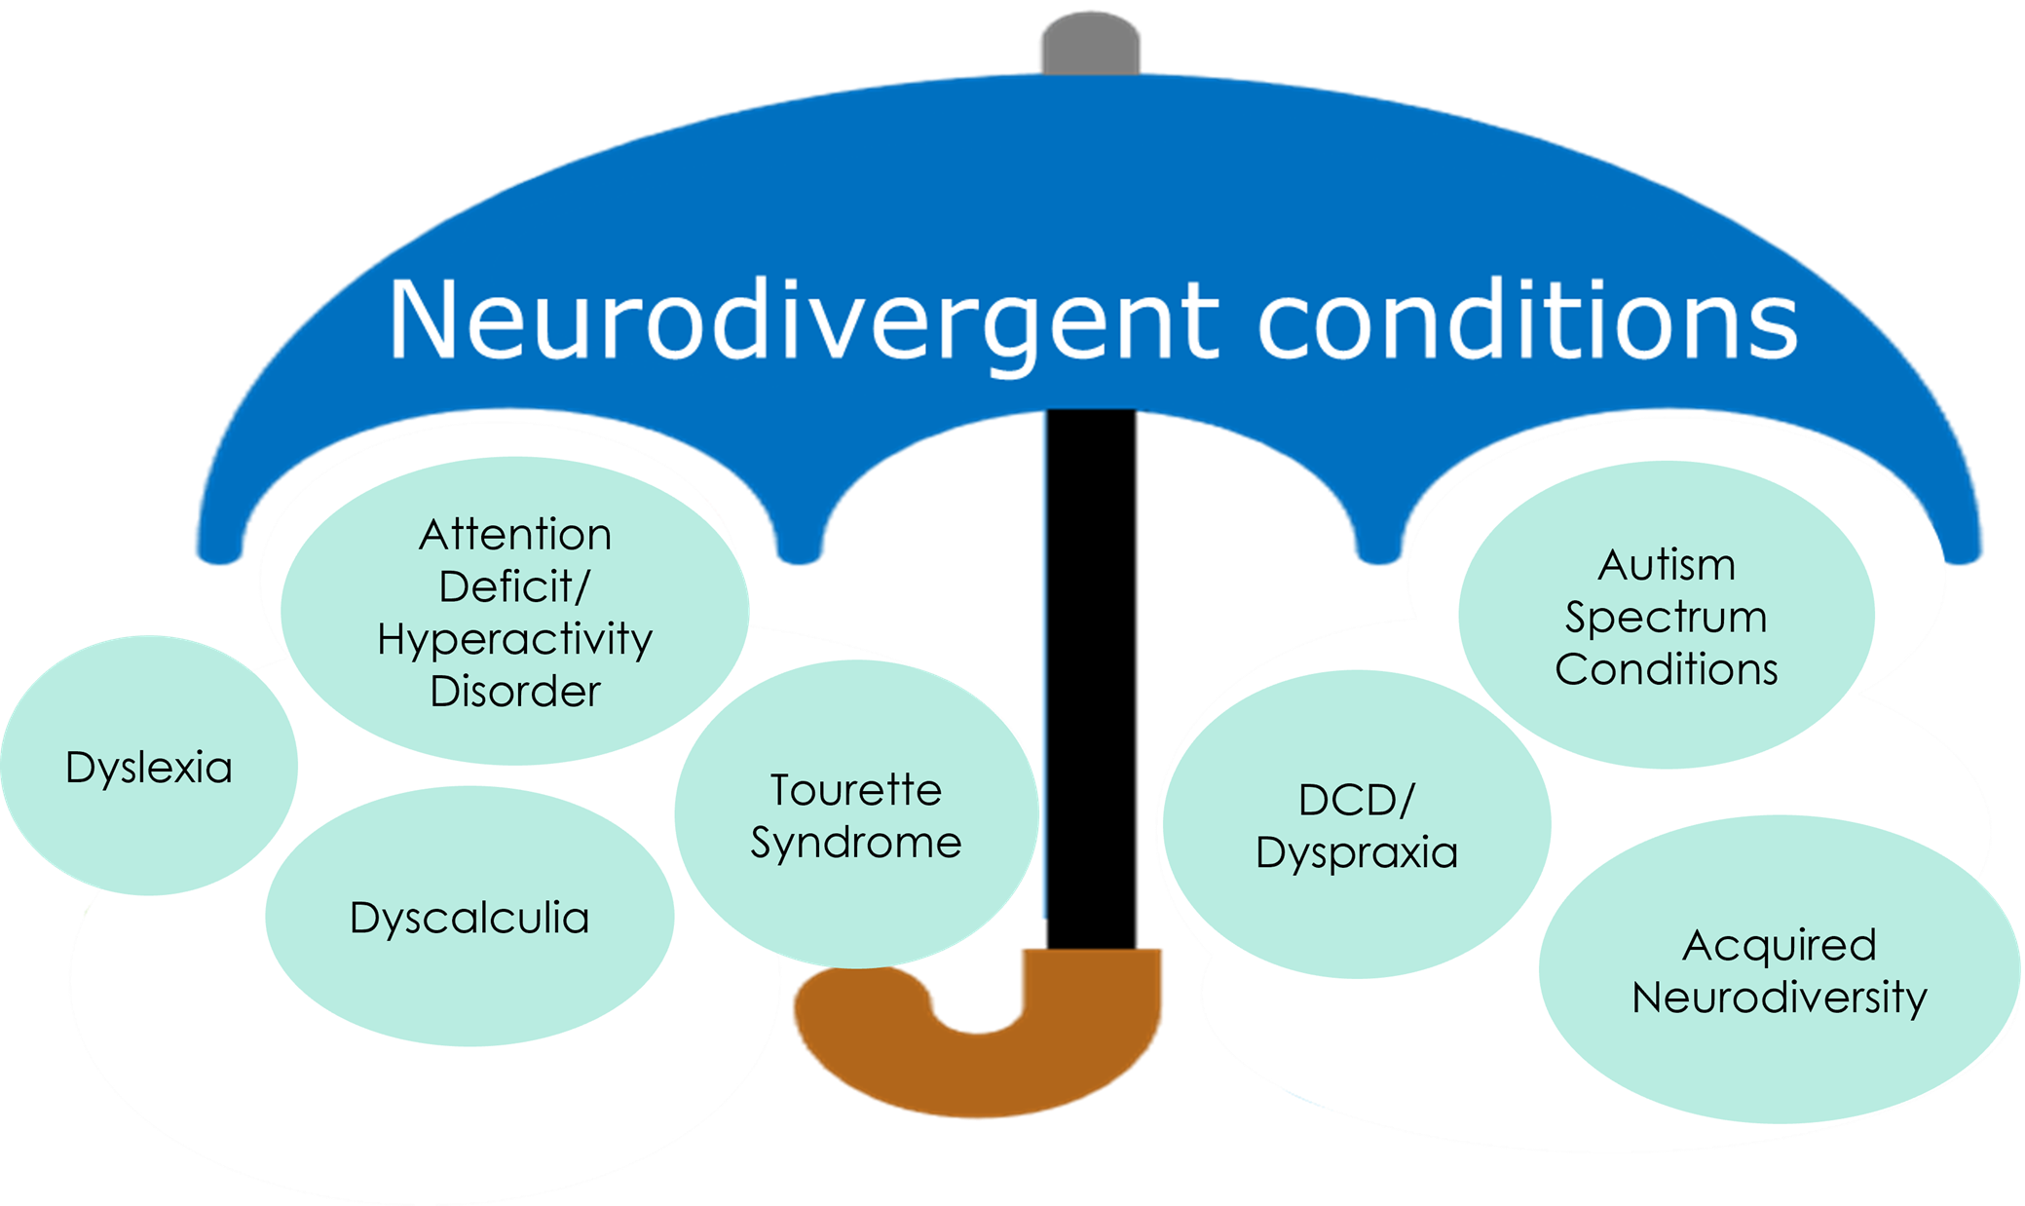
Notes:
Lisa
https://blogs.surrey.ac.uk/librarynews/2022/03/21/what-is-neurodiversity/

Slide 15
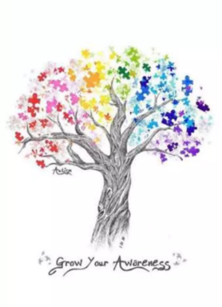
What can we do as a workforce on a personal level?
Get to know each other
Use person centered language
Question your own thoughts and attitudes towards individuals who have a disability
Say or do something if you see discrimination
Support inclusion
Notes:
Lisa

Slide 16
“Organisations must consider the broader picture; inclusion is more than simply 'including' diversity – it is about individual experience and work, and creating a positive environment in which everyone can influence, share knowledge and have their perspectives valued”
(The Chartered Institute of Personnel and Development, December 2022)
Notes:
Alice

Slide 17
Listens to our employees, which can make the organisation a great place to work
Can help our employees feel valued
Focuses on creating an inclusive environment
We help communicate that the organisation is a good employer
The stronger we are together the more likely we are to attract and retain!
Notes:
Alice

Slide 18
We have asked our colleagues, and their managers what matters most
They said…
Access the right support
Felt unable to ask for help
Worried that they might be treated differently
Afraid to speak up, or disclose their disability and/or condition
Notes:
Alice

Slide 19
What are reasonable adjustments?
Reasonable adjustments are modifications an employer makes to remove or reduce a disadvantage related to someone's disability
Making physical changes to the workplace, like installing a ramp for a wheelchair user or an audio-visual fire alarm for a deaf person
Letting a disabled person work somewhere else, such as on the ground floor for a wheelchair user
Changing their equipment, for instance providing a special keyboard or chair
Notes:
Alice
Reasonable adjustments are tailored to an individual person. They can cover any area of work.
https://grainesdesol.fr/blog/2018/01/26/linsertion-professionnelle-pour-les-personnes-handicapees-2/

Slide 20
Access to Work: get support for ‘reasonable adjustments’ if you have a disability or health condition
Notes:
Alice
​Access to Work is a government grant scheme which helps people with a disability or health condition to start or remain in employment. It can provide practical and financial support to help people overcome barriers within the workplace.
The support you get will depend on your individual needs.

Slide 21
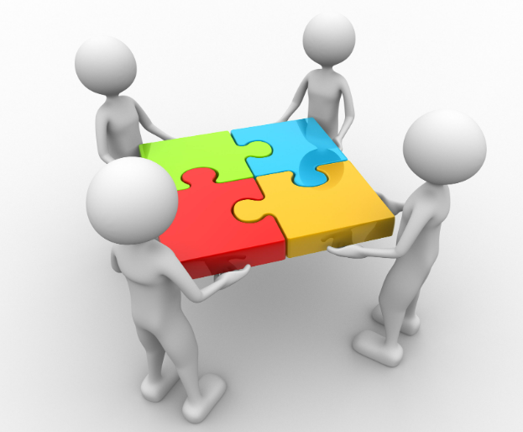
Access to Work can usually provide a grant to pay for the cost of the support, for an example it can provide funds towards:
Special aids and equipment
Adaptations to equipment
Travel to and from work
Communication support at interview
Support workers
Mental Health support
You are considered disabled if you have a physical or mental impairment which has a substantial and long-term adverse effect - beyond 12 months - on your ability to carry out day-to-day activities (Equality Act, 2010)
Notes:
Alice
https://workplacepartners.com.au/services/business-improvement/people/

Slide 22
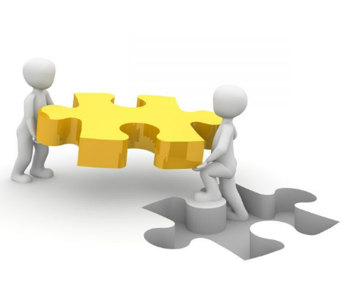
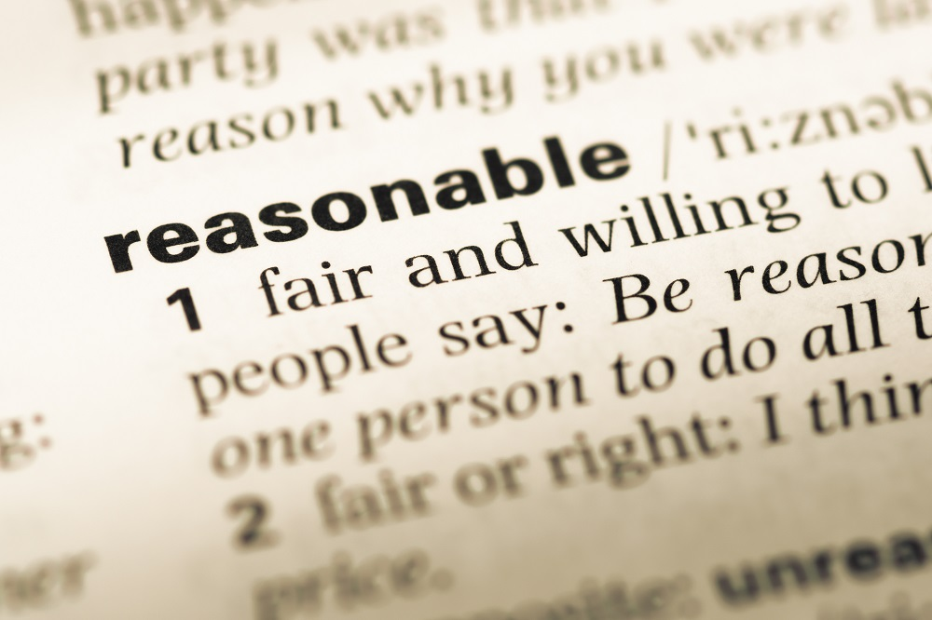
Help with the extra costs disabled people face in work
Many reasonable adjustments involve little or no cost and could include:
Making changes to a disabled person’s working pattern Providing training or mentoring Making alterations to the workplace premises Ensuring that information is provided in accessible formats Modifying or acquiring equipment and/or software Allowing extra time during exams
Notes:
Alice
https://www.121captions.com/2021/04/26/access-to-work/
https://practiceindex.co.uk/gp/blog/reasonable-adjustments-workplace-robyn-clark/
https://fluiditysoftware.com/

Slide 23
Let’s talk about ADHD
Notes:
Alice – pass over

Slide 24
What is ADHD?
Attention deficit hyperactivity disorder is a condition that affects people's behaviour.
People with ADHD can seem restless, may have trouble concentrating and may act on impulse.
(NHS UK, 2023)
Notes:
Lisa
Attention-deficit/hyperactivity disorder (ADHD) is a condition that affects millions of children and often continues into adulthood.
ADHD includes a combination of persistent problems, such as difficulty sustaining attention, hyperactivity and impulsive behaviour.
People with ADHD may struggle with low self-esteem, troubled relationships, poor performance in school and may struggle later in life in the workplace. However symptoms sometimes lessen with age.
Some people never completely outgrow their ADHD symptoms, but they can learn strategies to be successful.
Whilst treatment won't cure ADHD, it can help a great deal with symptoms. Treatment typically involves medications and behavioural interventions. Early diagnosis and treatment can make a big difference in outcome.
Attention-deficit/hyperactivity disorder (ADHD) in children - Symptoms and causes - Mayo Clinic
ADHD Nice - Bing images Cartoon Person Question Mark - Bing images

Slide 25
Whilst the exact cause of ADHD is not clear, research efforts continue. Factors that may be involved in the development of ADHD include genetics, the environment or problems with the central nervous system at key moments in development.
(Mayo Foundation for Medical Education and Research, 1998-2023)
Notes:
Lisa
Attention-deficit/hyperactivity
disorder (ADHD) in children - Symptoms and causes - Mayo Clinic
cause of adhd - Bing images

Slide 26
5 things you might not know about ADHD
1. The ADHD nervous system is a unique and special creation that regulates attention and emotions in different ways than in the nervous system in those without the condition; many adults with ADHD are not overtly hyperactive. They are hyperactive internally.
2. Those with ADHD do not have a shortage to attention. They pay too much attention to everything.
Notes:
Lisa

Slide 27
Most people without medication may have four or five things going on in their minds at once.
3. Most people with ADHD know they are clever but are unsure of when their abilities might show up when they need them. Their symptoms and impairments may come and go throughout their day, which makes the condition somewhat frustrating and mystifying for the individual.
4. People with ADHD often know they can ‘get in the zone’ at least four or five times a day. When they are in the ‘zone’ they have no impairments, and the executive function deficits they might have had before the ‘zone’ disappear.
Notes:
Lisa

Slide 28
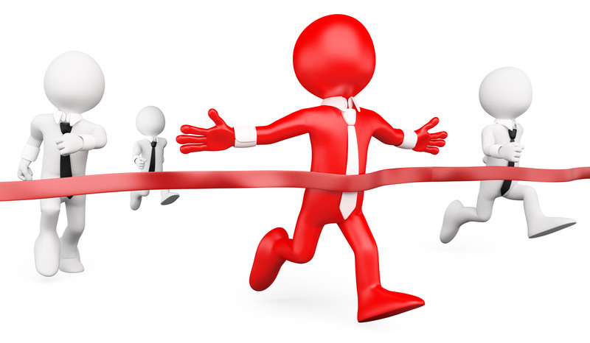
Most people without medication may have four or five things going on in their minds at once.
5. Interesting or intriguing activities/tasks often help a person with ADHD get in the ‘zone’ or at times when they are challenged or placed into a competitive environment, such as: a new task attracts their attention but new gets old after a while and their attention or interest can be lost.
(William Dodson, M.D)
Notes:
Lisa
There are three subtypes of ADHD:
- Hyperactive-impulsive subtype
Inattention subtype
Combined subtype
ADHD Information. Treatment and Symptoms of ADHD | Patient
compete image - Bing images

Slide 29
About ADHD - ADHD UK
Notes:
Alice
ADHD Nice - Bing images

Slide 30
Inattention
Often has trouble holding attention on tasks
Often does not seem to listen when spoken to directly
Often does not follow through on instructions and fails to carry out chores, or duties in the workplace (e.g., loses focus, side-tracked)
Often has trouble organising tasks and activities
Often avoids, dislikes, or is reluctant to do tasks that require mental effort over a long period of time
Often loses things necessary for tasks and activities (e.g., pencils, books, keys, paperwork, eyeglasses, mobile telephones).
Is often easily distracted
Notes:
Alice
Three Subtypes of ADHD
ADHD inattentive type: This type of ADHD is characterized by symptoms of inattention. People with this type of ADHD may have few or no symptoms of hyperactivity and impulsivity. This form of ADHD is sometimes referred to as attention deficit disorder (ADD), although the term ADD is an outdated one that is not often used anymore.
Some symptoms can include…
ADHD Inattentive Type: Symptoms, Diagnosis, and Treatment (verywellmind.com)
inattention adhd - Bing images

Slide 31
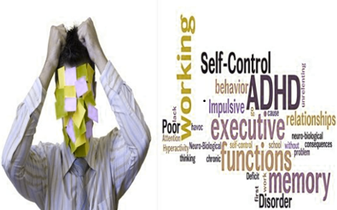
Hyperactivity and Impulsivity
Internal energy that must be used!
Often fidgets or taps hands or feet
Adults may feel restless
Often unable to play or take part in leisure activities quietly
Is often “on the go” acting as if “driven by a motor”
Often talks excessively
Often blurts out an answer before a question has been completed
Often has trouble waiting their turn
Often interrupts,
impatience (from needing to do)
Notes:
Alice
ADHD hyperactive/impulsive type: This type of ADHD is characterized by symptoms of hyperactivity and impulsivity. People with this type of ADHD may have few or no symptoms of inattention.
Symptoms can include..
Often most individuals have ADHD combined type: People who have ADHD combined type have symptoms of inattention as well as symptoms of hyperactivity and impulsivity. This is the most common type of ADHD.
ADHD Inattentive Type: Symptoms, Diagnosis, and Treatment (verywellmind.com)
hyperactivity adhd - Bing images
impulse at work for adhd - Bing images

Slide 32
STATS & FACTS……
5% of children in the UK have ADHD
An adult incidence of 3-4% with majority undiagnosed
Diagnosed at all ages
Strategic adaptations work – reasonable adjustments in the workplace can help in many circumstances/situations
Notes:
Lisa
To go with 5% FACT
That provides for a total estimate of 2.6million people in the UK with ADHD
Facts
The NHS has accepted ADHD as a condition since 2009. It is possible to access diagnosis and treatment through the NHS but it must be done through a GP
There are three subtypes of ADHD:
- Hyperactive-impulsive subtype
Inattention subtype
Combined subtype
ADHD Facts │ UK Statistics (adhdcoaching.org)
ADHD Incidence - ADHD UK
stats images - Bing images ADHD Information. Treatment and Symptoms of ADHD | Patient

Slide 33
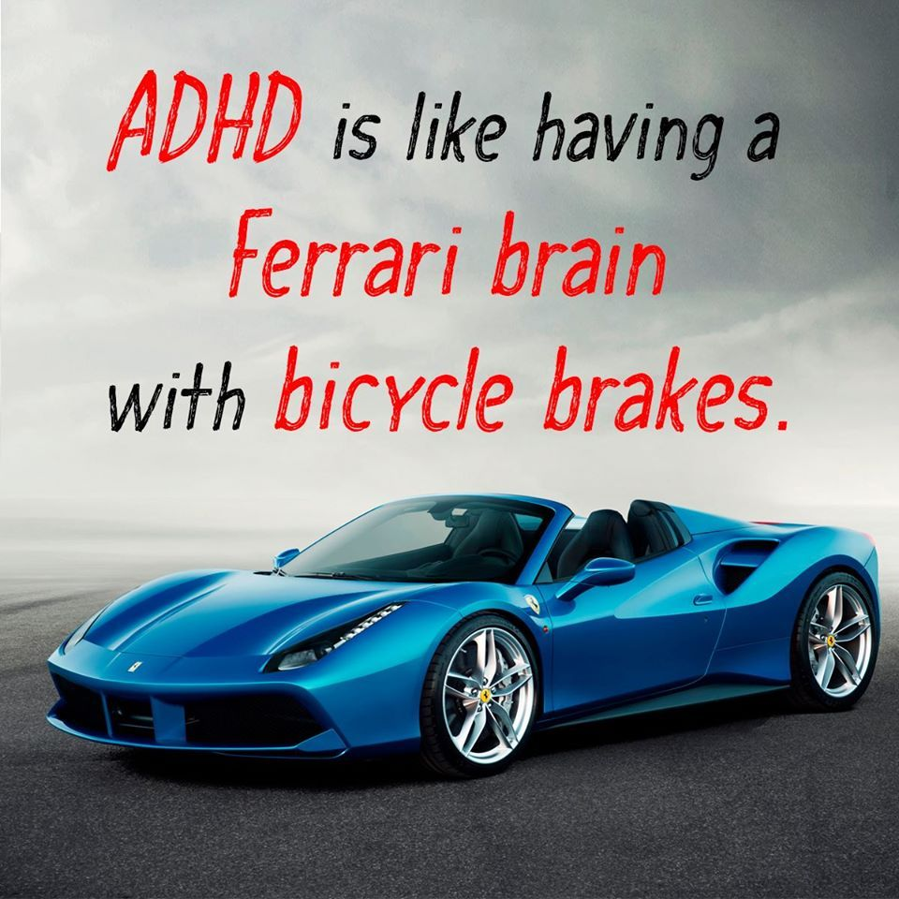
ADHD’s Favourite Analogy:
Race car brain with bicycle steering
More raw brain power than control
Under steering = inattention
Over steering = hyperfocus
Notes:
Lisa
adhd race car - Bing images
On this slide I am going to refer to Mr Ferrari,
How others might perceive a person with ADHD to be: Not waiting to speak, butting in on conversations when actually it is because Mr Ferrari has a poor working memory, if he doesn't jump in; he will forget.
People can be considered rude or arrogant due to talking over others. Infact Mr Ferrari has listened really hard and valued what has been said. He has often learnt that his relationships can be affected by this.
When Mr Ferrari’s wife has something interesting to say, he might appear to have left the conversation but its not the case he is often thinking about something that was mentioned earlier, quite possibly what is for dinner.
He tries really hard not fidget and will cross his arms, which appears he wants to leave the conversation. If a person with ADHD is asked to sit for a prolonged amount of time and have no where to vent or fidget this can be a real challenge and can really over sensitise an individual.
Mr Ferrari can often forget things that are said and has been told in the past he is rude or he has heard colleagues gossip saying he is stupid. He has a few times been late to team meetings, but it’s not because he is ignorant, its because he’s been focused on a task and has forgotten the time.
He finds setting reminders on his mobile phone helps him stay on track. He has also learnt that writing lists of things to do overwhelming so now likes to simplify them.
His colleagues wonder if he chooses when he wishes to focus on certain tasks but this is not true this is known as Hyper focus.
Information found from ADHD Foundation speaker

Slide 34
Why do people with ADHD forget sometimes?
Working memory is the ability to have data available in one's mind and to be able to manipulate the data to produce a plan, answer or action, but those with ADHD their minds are full of things such as “where are my keys?” and many other racing thoughts, giving little time or room left for new thoughts and memories.
Something must be forgotten or discarded to make room for new information. Often the information is in their memory, just not always available on demand.
Notes:
Lisa

Slide 35
Notes:
Lisa
forgetful images - Bing images

Slide 36
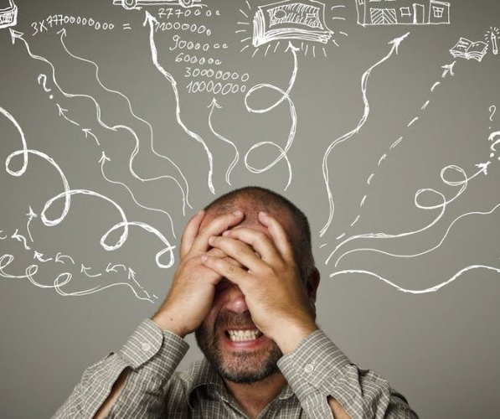
How can working memory be improved?
Break tasks and chunks of information into bitesize manageable pieces
Use checklists – it can help with prioritising important tasks
Create / establish a routine, such as: place your keys in the same place everyday
Complete one task and then move on - it can help having micro-breaks after a heavy task
Mindfulness – helpful for tuning out distractions and overall good for the mind and body
Notes:
Lisa
Improve Working Memory: Brain Training Tricks (additudemag.com)
ADHD Disorganised - Bing images
https://ciplamed.com/content/attention-deficit-hyperactivity-disorder-adhd

Slide 37
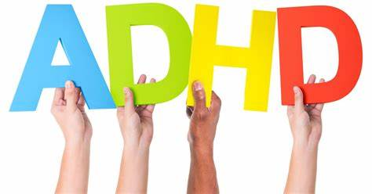
How To Turn ADHD Into a Superpower - YouTube
Notes:
How To Turn ADHD Into a Superpower – YouTube
super power of adhd youtube - Bing images
Alice

Slide 38
What are some ADHD benefits?
Notes:
Alice
Remind everyone that there are important strengths too, not just challenges!
Individuals with ADHD are often highly creative, especially when given a goal-oriented task. Living with ADHD also requires people to approach tasks differently, which means they can become great problem solvers. People with ADHD can come up with creative solutions that others may not see. They can bring energy and new approaches to their projects, and be a continual source of new ideas, methods, and strategies.
What are the benefits of ADHD? (medicalnewstoday.com)
https://www.pinterest.com/pin/123356477281394305/

Slide 39
What can general accommodations look like?
Assistive technology (timers, apps, calendars and so on)
Being provided with a rota in advance and not short notice
Providing a coach to suggest ways to increase productivity and maintain a healthy work-life balance
Notes:
Alice
Some accommodations can be allowing the individual to work from home depending on the need of the service.
To help with focus and concentration
Provide a private/allocated workspace
Taking micro-breaks
Time management
Assigned mentor or also known as buddy
Provided with to do lists
Meetings to discuss expectations
Assistance with prioritisation
- Help identify strengths instead of focusing on weaknesses
Reinforcing creativity
A sign that an individual might be struggling and need adjustments and/or coping strategies is by recognising they are overworking or – not taking holidays, using their annual leave, staying at work late frequently, not having a lunch break – microbreaks – protected admin work – regular 121's with manager / check ins can help and adding reminders to calendars.

Slide 40
In what other ways can EDNA help?
Explore limitations that the employee is experiencing
Look at how these limitations affect the employee and the employee’s job performance
What accommodations are available to reduce or eliminate these problems? Explore if all possible resources are being used to determine possible accommodations
Once accommodations are in place, it can be useful to follow up with the employee to evaluate the effectiveness of the accommodations and to determine whether additional accommodations are needed
We can support managers or their team and help raise awareness and/or understanding
What specific job tasks are problematic as a result of these limitations
Notes:
Attention Deficit/Hyperactivity Disorder (AD/HD) (askjan.org)
Lisa

Slide 41
Quiz time!!!!!

Slide 42
What is the percentage for adults with ADHD?
ADHD occurs more in women than men! True or False?
Can you give one example of a reasonable adjustment?
If you have ADHD what do you consider to be your main strength? Please add in the chat if your happy to share
Notes:
celebs who have adhd - Bing images

Slide 43
Let's work together to develop strategies to ensure all NHS employees have a voice!
EDNA can work with employee network groups to facilitate two-way conversations about equality and diversity!
We aim to cater appropriately for the needs and preferences of individuals and work in partnership with the employee and the employer!
The service advocates inclusion in a safe space!
Notes:
Disability & Employment | Factsheets | CIPD
Health matters: health and work - GOV.UK (www.gov.uk)
Lisa

Slide 44
Happy employees are proven to be more productive, with loyalty to our employees the outcome is a strong reputation which attracts great talent that fosters powerful growth and opens the talent pool.
By breaking barriers of the old-fashioned work environment, we make room for an innovative atmosphere, where new ideas, new methods, new ways of working are celebrated and welcomed!
Notes:
Lisa

Slide 45
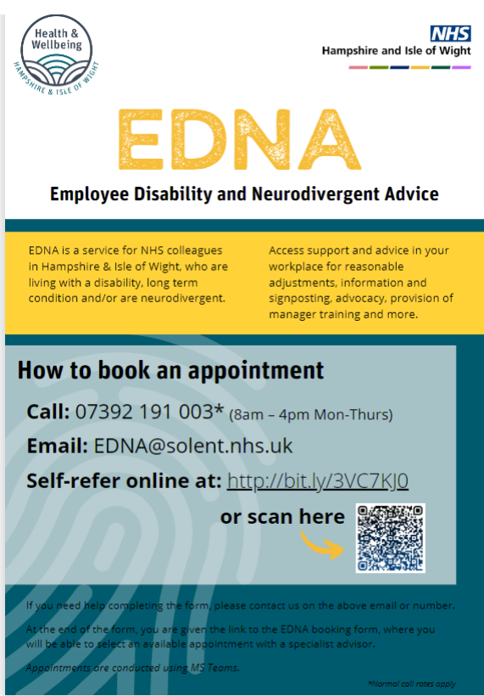
Notes:
Poster
I would like to tell you a bit about how to book an appointment with our friendly advisors, look out for these posters from which you can scan the link or make a note of the email address Edna@solent.nhs.uk and we will send out a link to the self-referral form –this form must be completed for your booking as it is important that we receive this form before your actual appointment so that at your appointment the advisors have had all your information this then ensures they are aware of some of your needs and can research the best way to support, signpost or advise you.

Slide 46
Wants to help change the workplace culture and reduce turnover!
We aim to support our employees so that their talents can shine!
Notes:
Lisa

Slide 47
Thank you for your time!
Any questions?
Notes:
http://www.lifeontheslowlane.co.uk/2017/07/24/we-can-and-we-do-highlighting-the-ability-in-disability/
http://rsh-bonn.de/?paged=4&cat=1
Lisa

